Slide 1
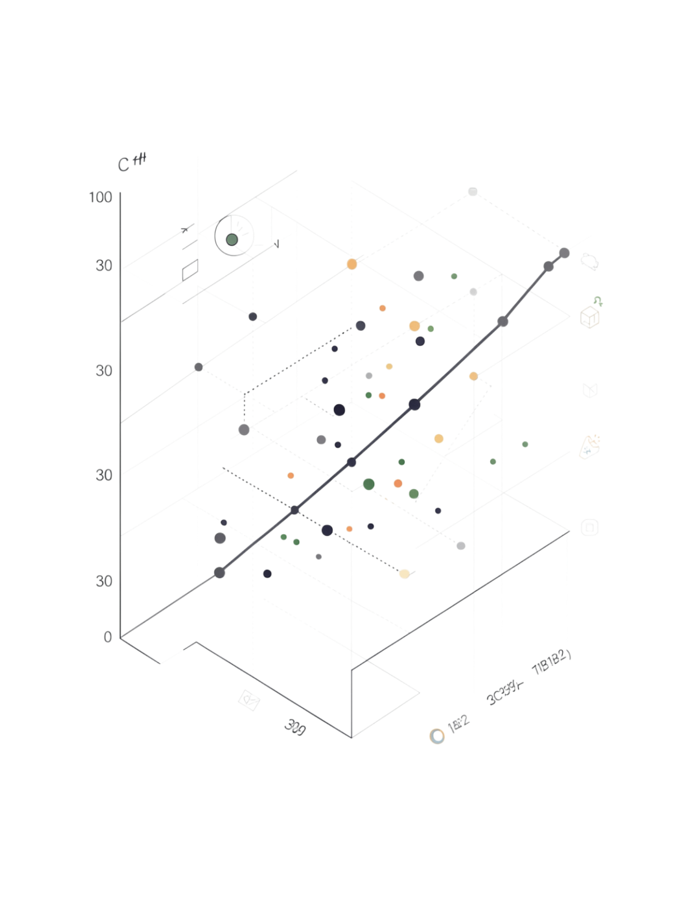
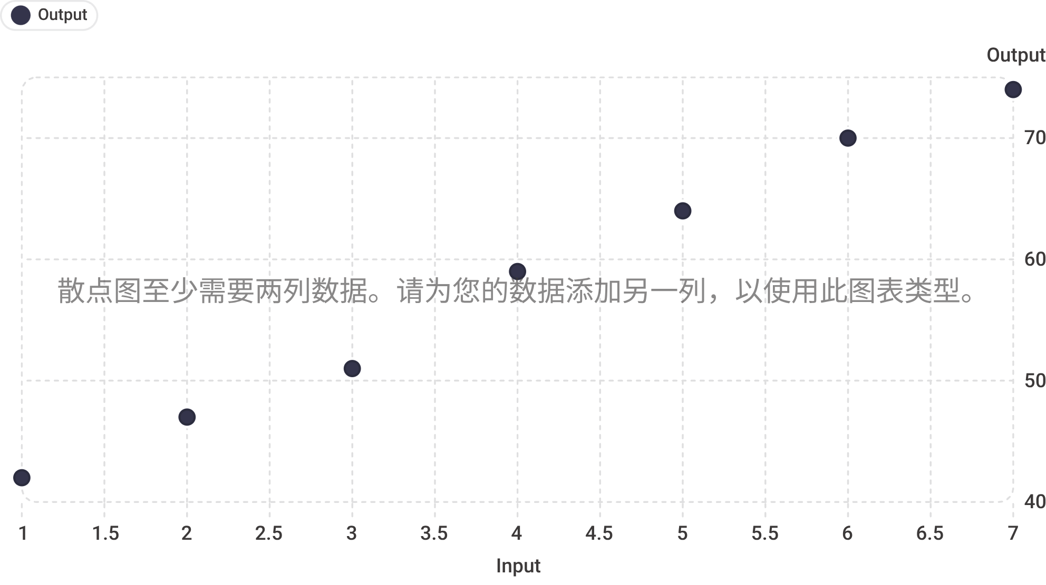
Linear Regression
A foundational Machine Learning algorithm for predicting continuous numerical values — from house prices to exam scores to salaries.

Slide 2
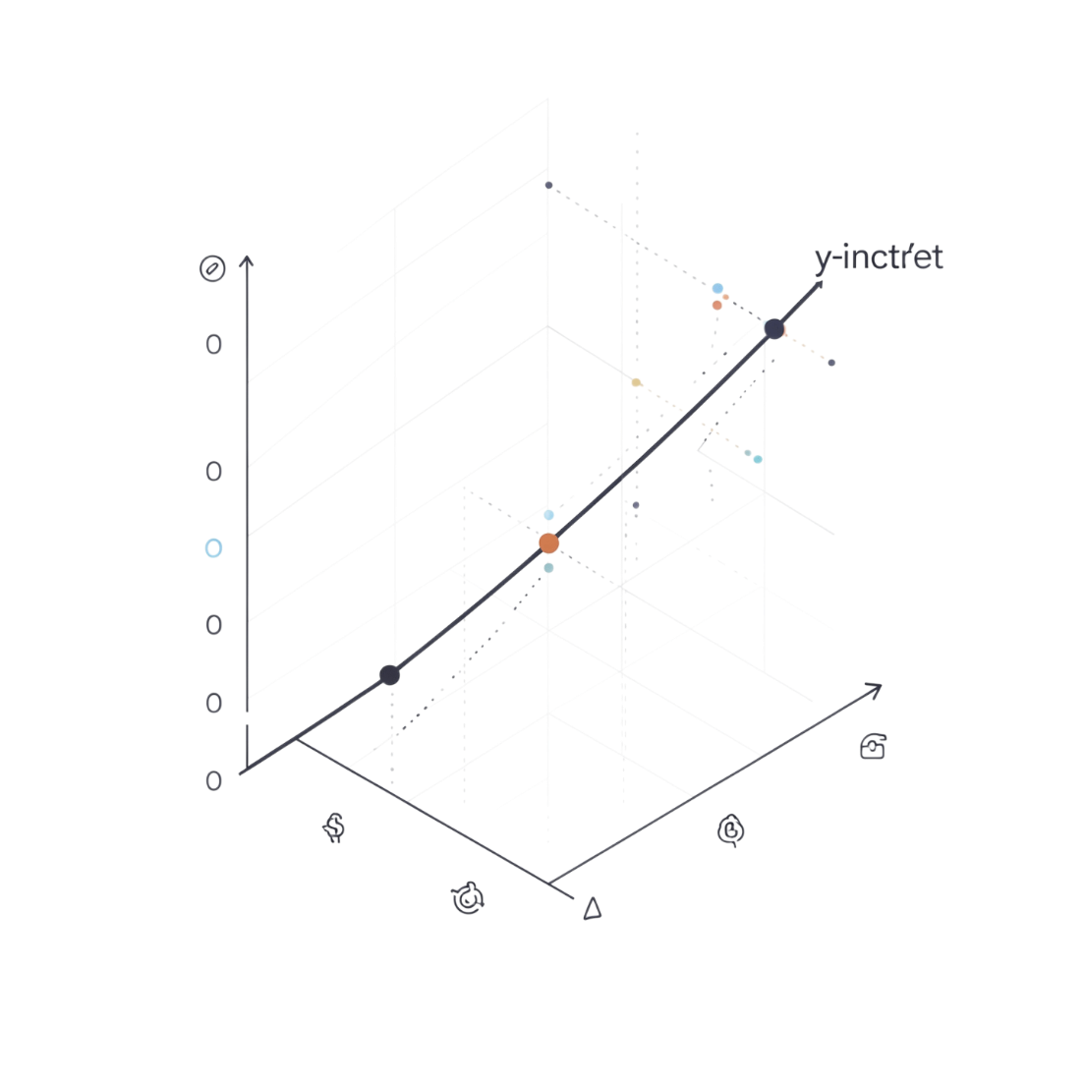

Linear Regression Formula
y = mx + b
y — Predicted Value
x — Input Value
The dependent variable / output we want to estimate.
The independent variable / feature we provide.
m — Slope
b — Y-Intercept / Bias
How much y changes when x increases by 1 unit.
The predicted value of y when x = 0.

Slide 3


Understanding Regression
Regression is used to predict numerical / continuous values. It identifies relationships between variables so that one can be used to predict another.
Example: Hours Studied → Exam Score
Hours Studied
Linear Regression
Predicted Score
Independent Variable (X)
Dependent Variable (Y)
Input · Predictor · Feature
Output · Target

Slide 4


Mathematical Example: y = 5x + 40
Predicting exam scores based on hours studied. The regression equation is y = 5x + 40, where m = 5 and b = 40.
1
Plug in x = 6 hours
Key Insight
y = 5(6) + 40
For every additional hour studied, the predicted exam score increases by 5 marks.
2
Calculate
y = 30 + 40
A student studying 6 hours is predicted to score approximately 70 marks.
3
Result
y = 70 marks

Slide 5


Deriving the Linear Regression Formula
The goal of linear regression is to find the best-fitting straight line through a set of data points. The Least Squares Method provides a way to calculate the optimal slope (m) and y-intercept (b) for this line by minimizing the sum of the squared vertical distances (residuals) between the observed data points and the regression line.
Formula for Slope (m)
Formula for Y-Intercept (b)
m — Slope
b — Y-Intercept
x_i — Individual X-Value
y_i — Individual Y-Value
Represents the change in the dependent variable (y) for every one-unit change in the independent variable (x).
The predicted value of y when x is zero. It's where the regression line crosses the y-axis.
A single observed value for the independent variable from your dataset.
A single observed value for the dependent variable corresponding to x_i.
\bar{x} — Mean of X
\bar{y} — Mean of Y
\sum — Summation
The average of all independent variable values in the dataset.
The average of all dependent variable values in the dataset.
Indicates the sum of all values that follow, calculated across all data points.
The Least Squares Method minimizes the sum of the squared errors (residuals) by finding the line that is closest to all data points. Squaring the errors ensures that all deviations (both positive and negative) contribute positively to the sum, and it disproportionately penalizes larger errors, pushing the line to fit the bulk of the data more closely.

Slide 6
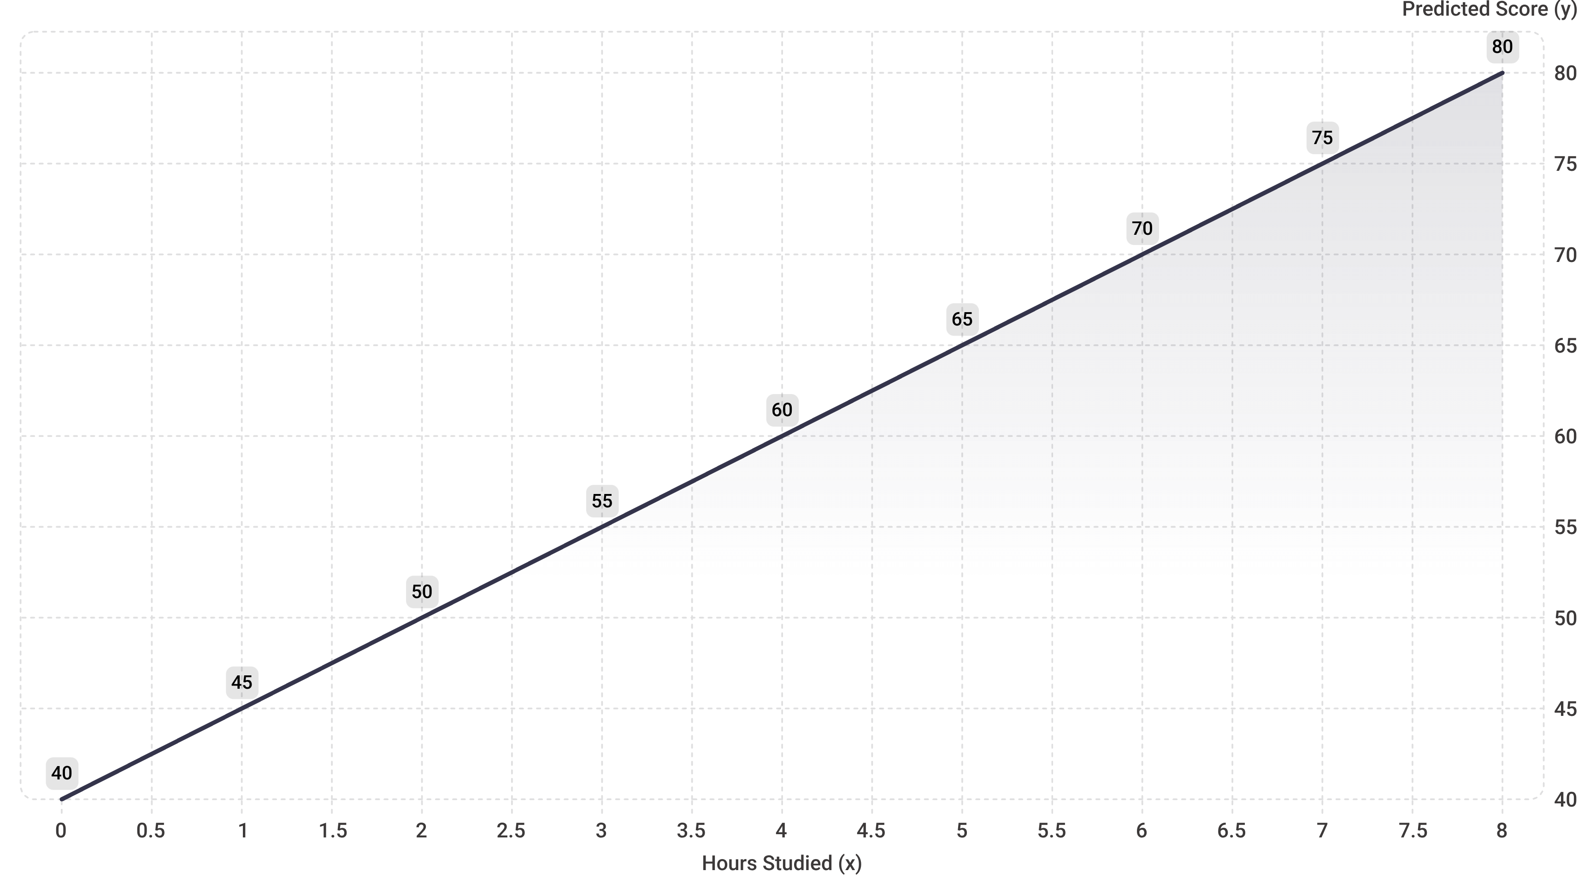
Plotting the Regression Line: y = 5x + 40
Y-Intercept (0, 40)
Key Point (6, 70)
Slope = 5
Predicted score when 0 hours studied.
6 hours studied → 70 marks predicted.
Each extra hour adds 5 marks to the score.

Slide 7
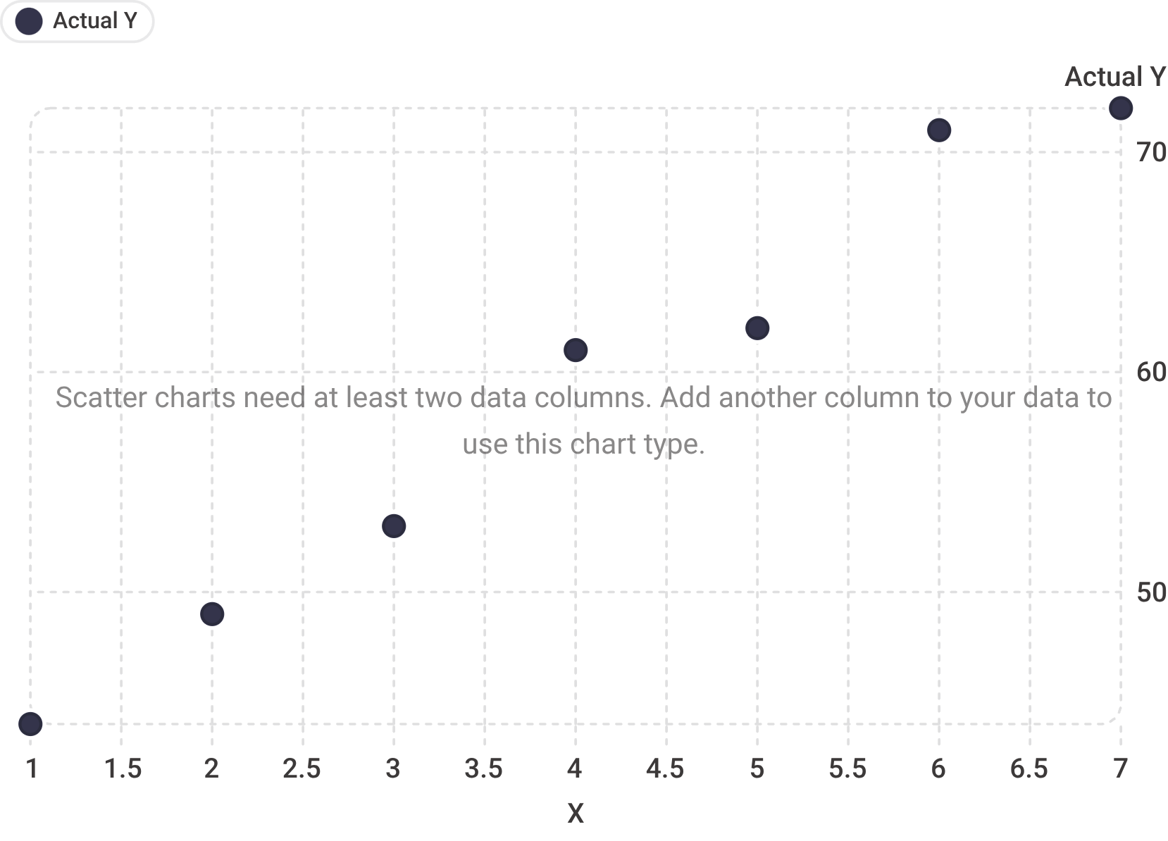


How Linear Regression Finds the Best Line
Real-world data does not fall perfectly on a straight line. Each data point has a gap from the predicted line — called a residual.
Linear Regression finds the line that makes these prediction errors as small as possible — the Line of Best Fit.
Actual Value: y
Predicted Value: ŷ
Residual: e = y − ŷ
The real observed data point.
The value the model estimates.
The vertical distance between actual and predicted — shown as dotted lines on the chart.

Slide 8
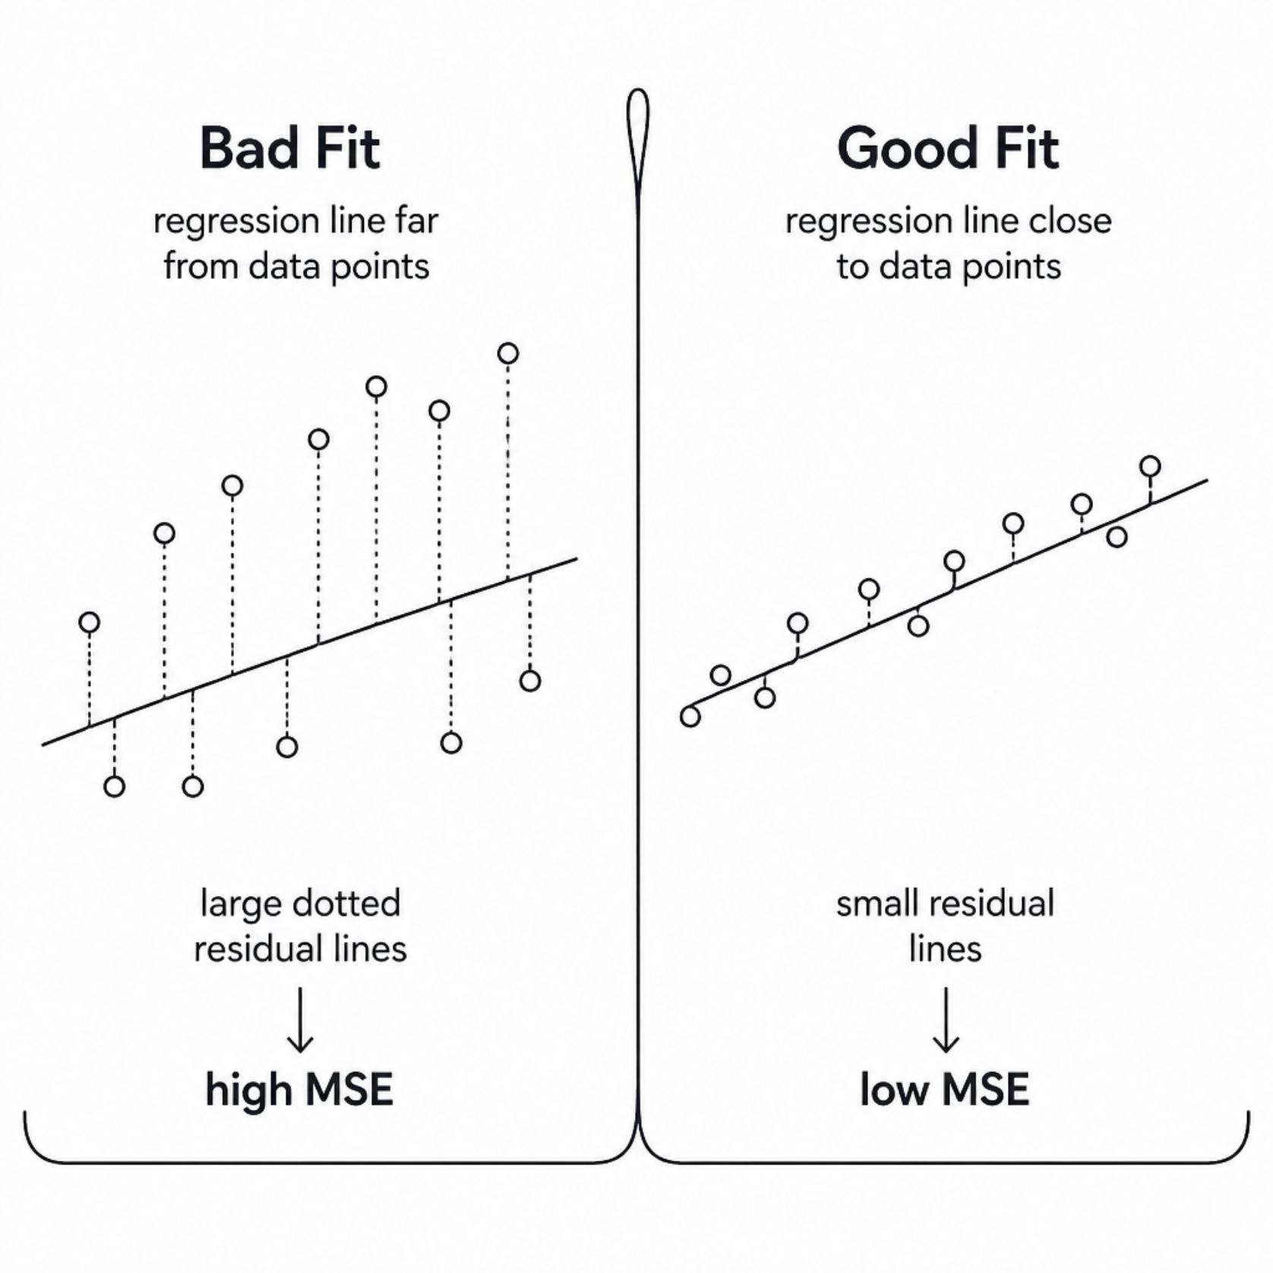
Mean Squared Error and Best Fit
To find the best line, Linear Regression minimizes a cost / loss function. The most common is Mean Squared Error (MSE).
MSE = (1/n) Σ(yᵢ − ŷᵢ)²
01
02
n — Number of observations
yᵢ − ŷᵢ — Prediction error / residual
03
04
Squaring prevents positive and negative errors from cancelling out
Goal: find m and b that minimize MSE

Slide 9
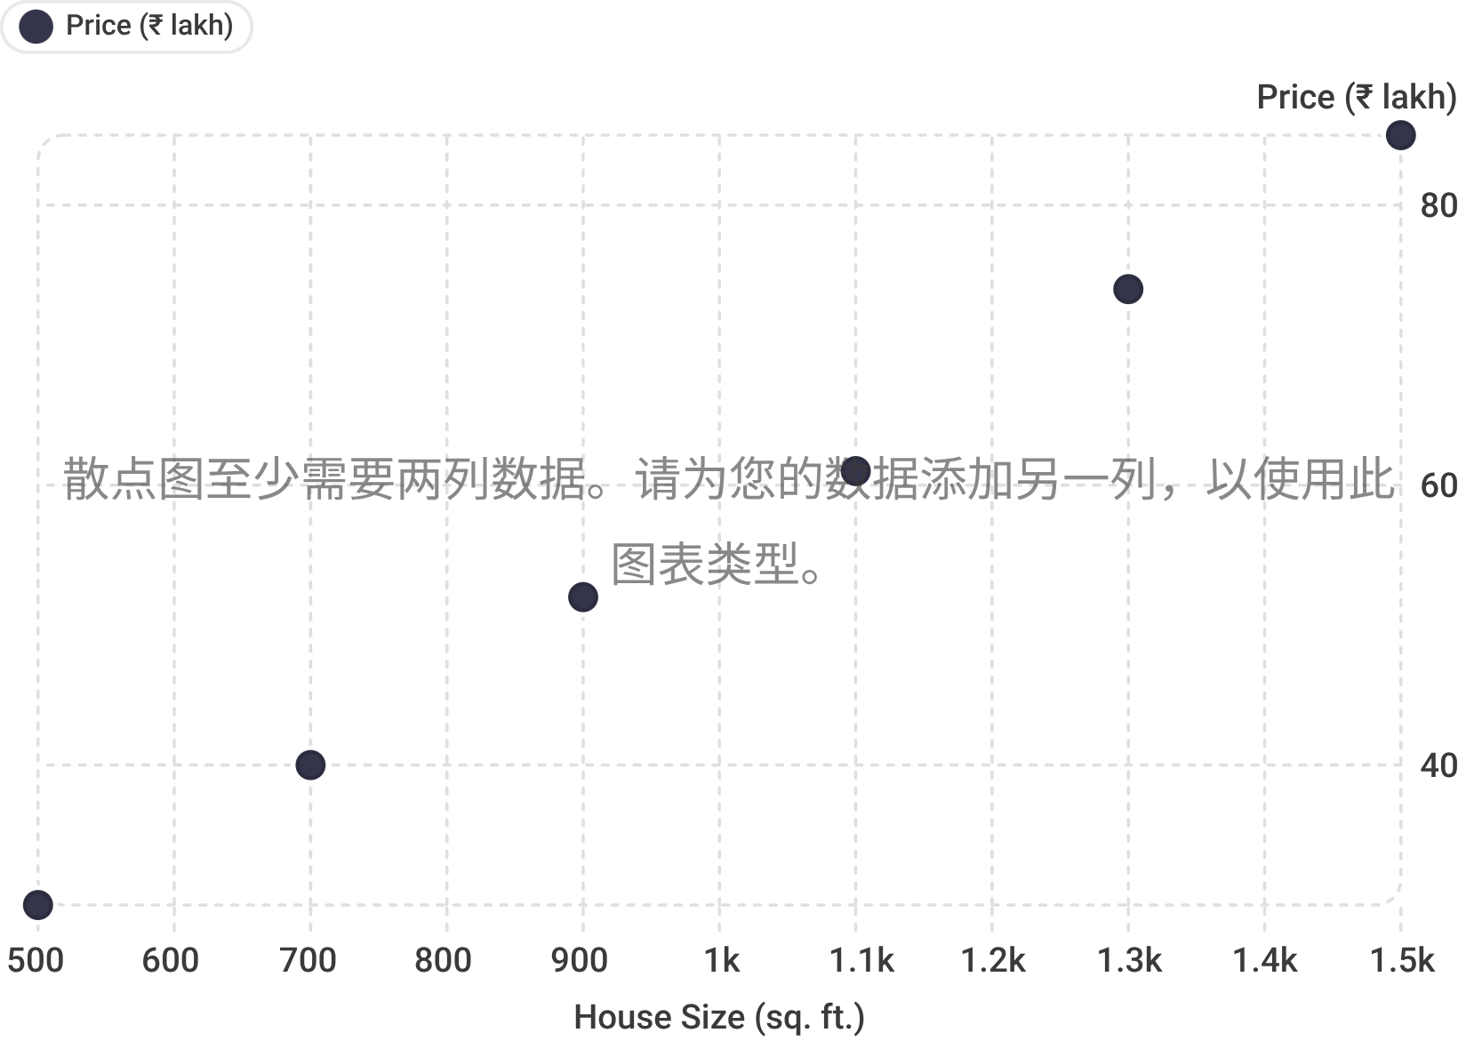
Real-World Example: House Price Prediction
House Size → House Price — Linear Regression learns from historical data to estimate the price of a new house.
House Size (sq. ft.)
Price (₹ lakh)
500
30
700
40
900
52
1100
61
1300
74
1500
85

Slide 10
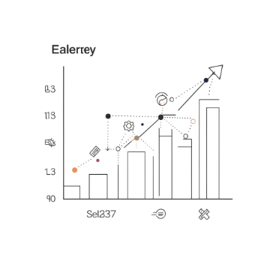

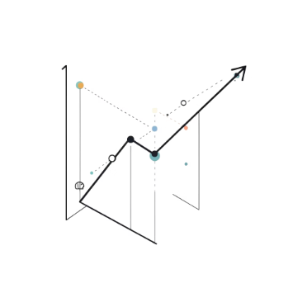


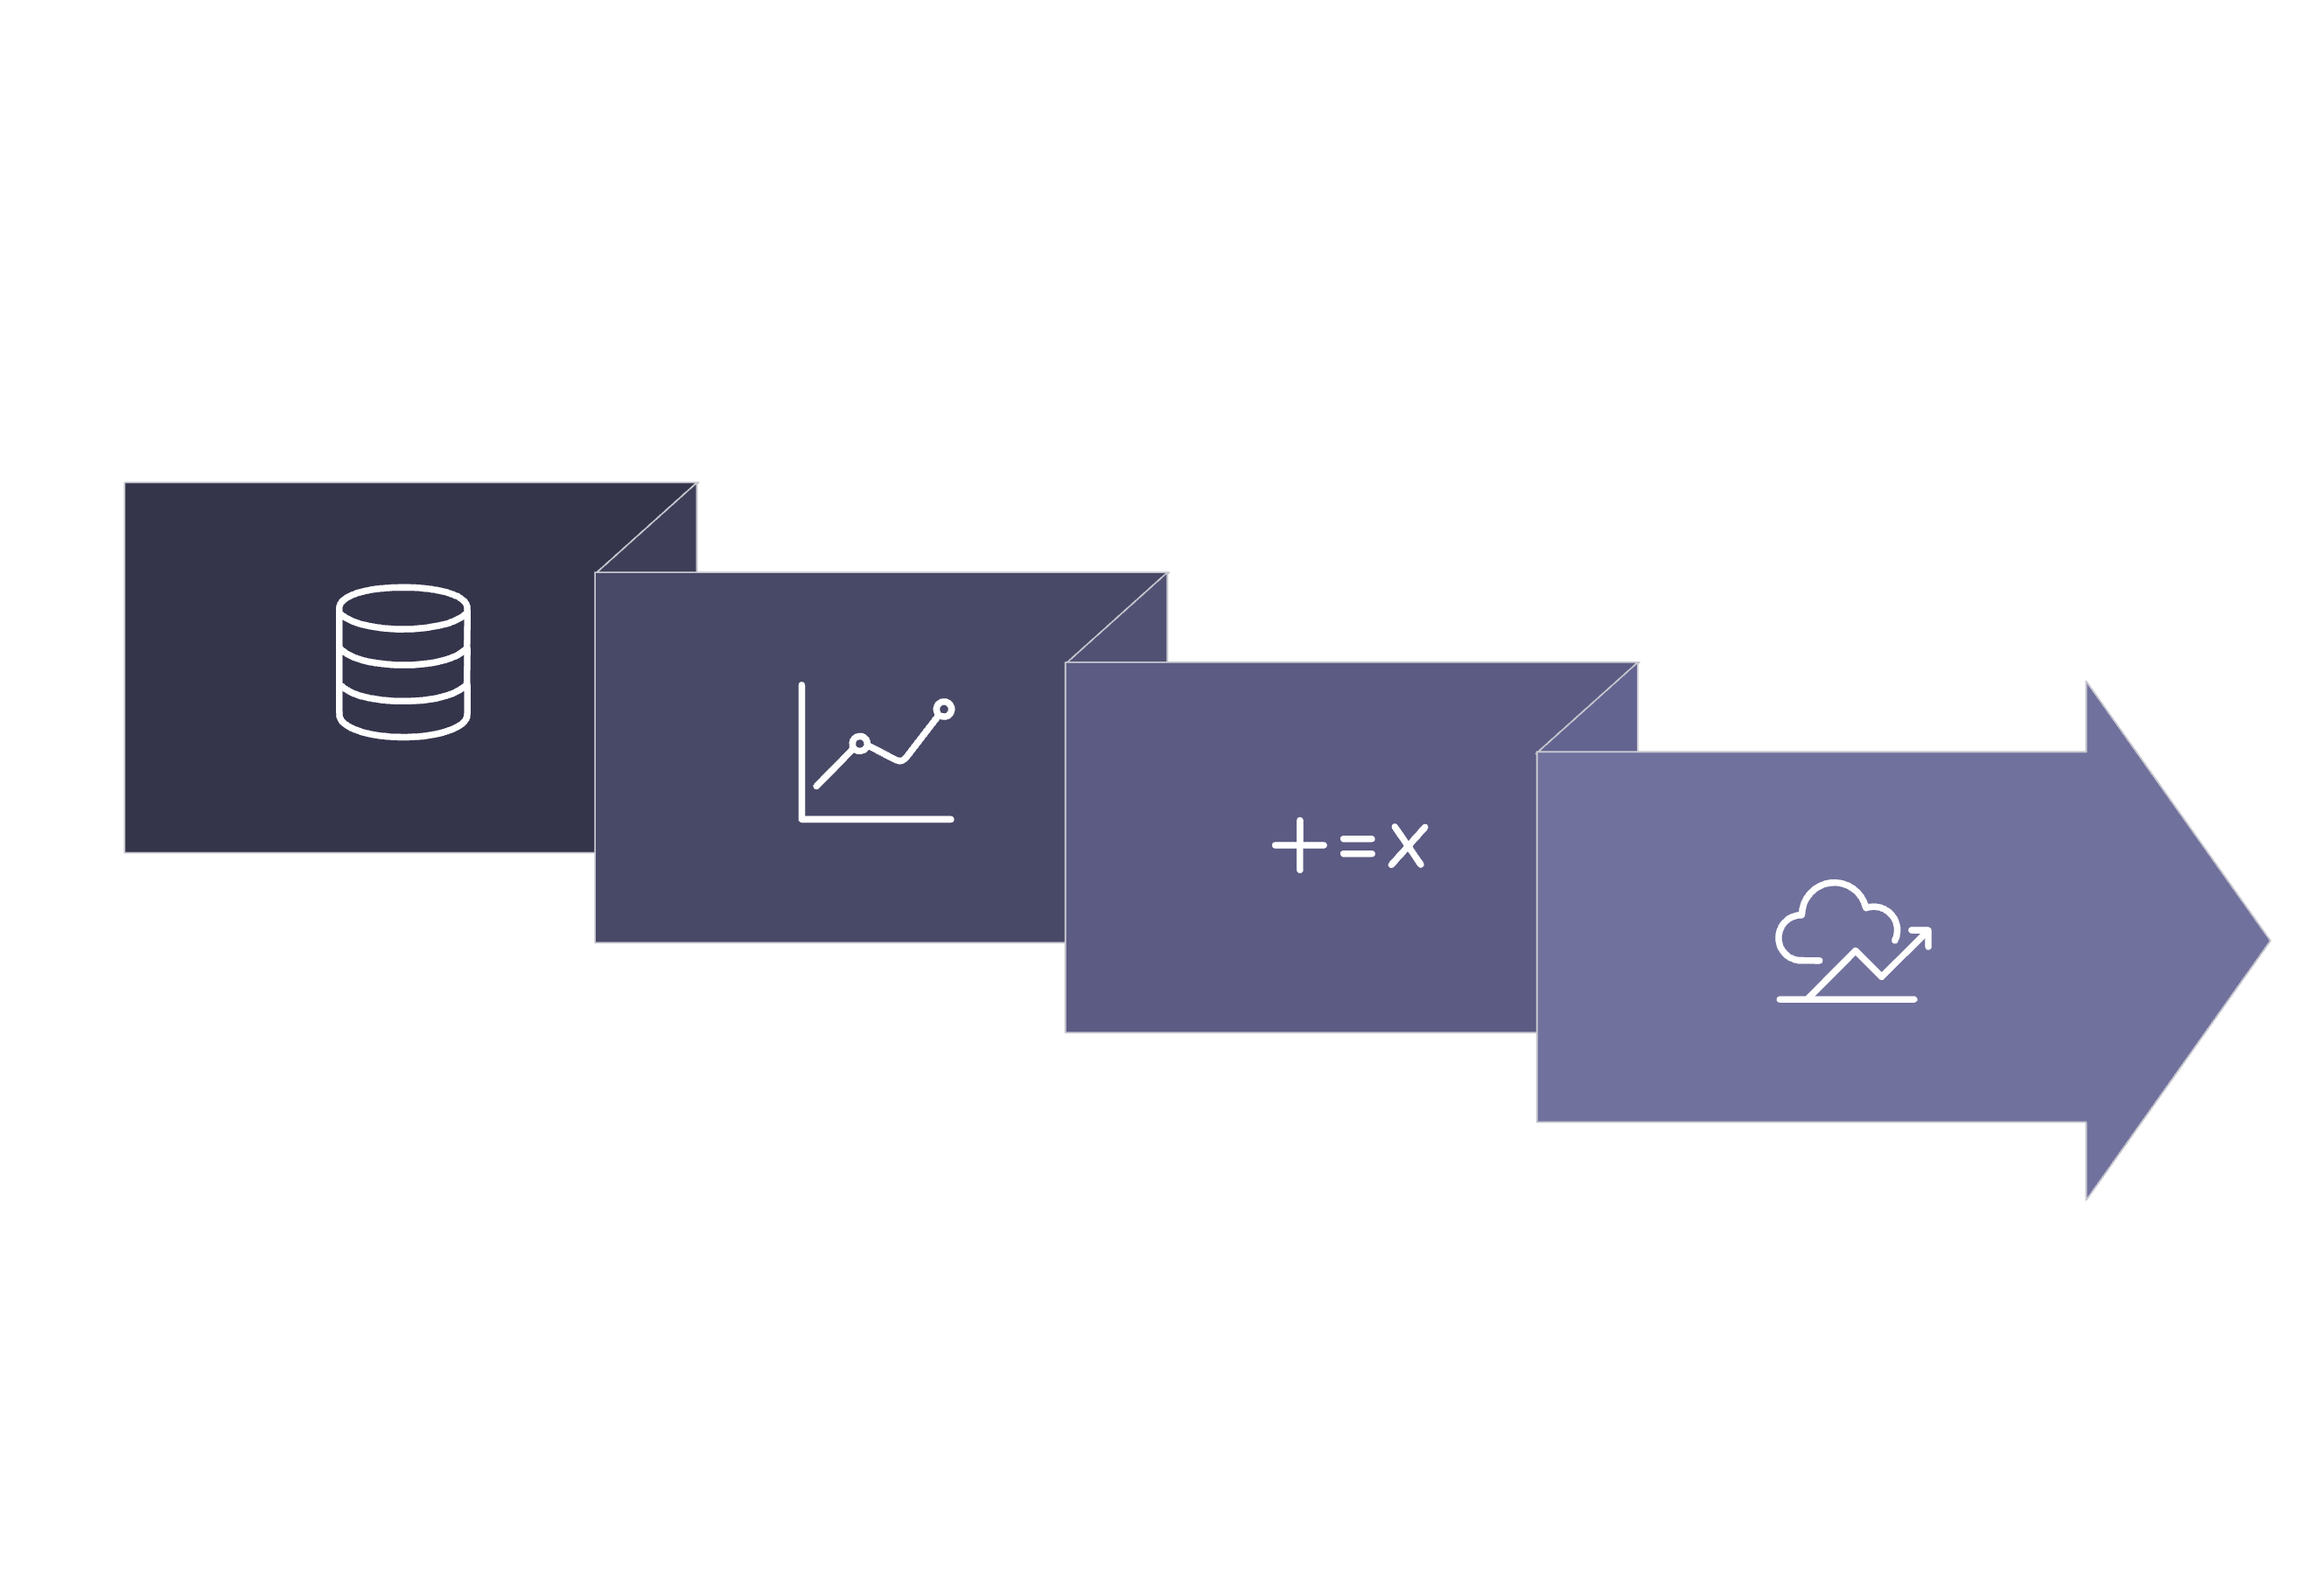
Applications of Linear Regression
Beyond house prices, Linear Regression powers predictions across many real-world domains.
Salary Prediction
Sales Forecasting
Demand Prediction
Temperature Analysis
Years of experience → Expected salary.
Historical sales data → Future revenue estimates.
Market signals → Product demand forecasts.
Time and location → Temperature predictions.
Advertising vs Sales
Ad spend → Predicted sales revenue.
Linear Regression
Prediction
Historical Data
Learned Relationship

Slide 11
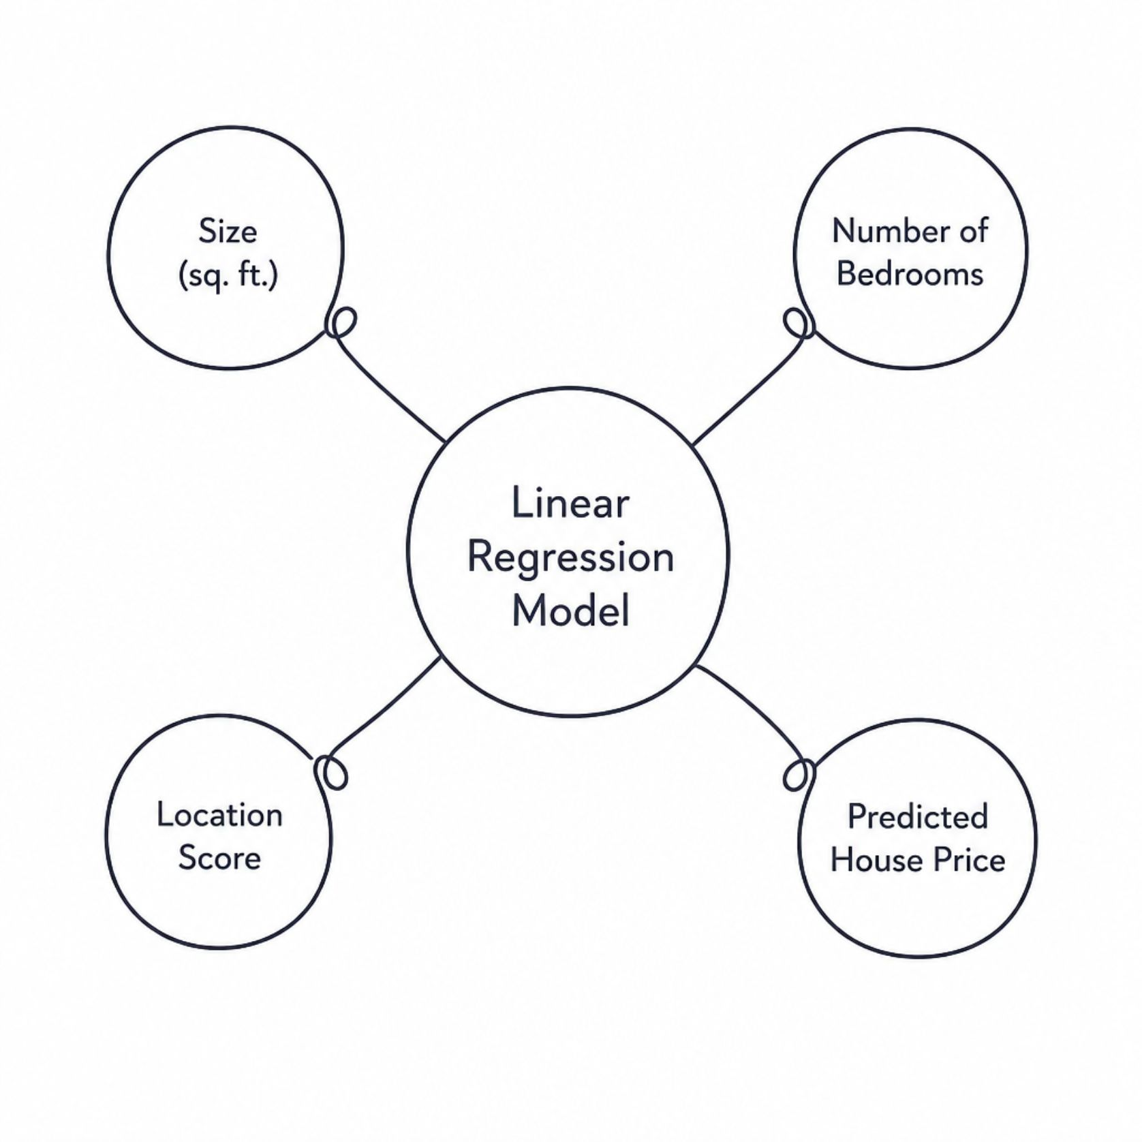
Simple vs Multiple Linear Regression
Simple Linear Regression
Multiple Linear Regression
Uses one independent variable.
Salary = m(Experience) + b
Experience → Salary
Uses multiple independent variables.
y = b₀ + b₁x₁ + b₂x₂ + ... + bₙxₙ
Price = b₀ + b₁(Size) + b₂(Bedrooms) + b₃(Location Score)

